Slide 1
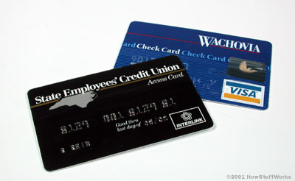
How Do ATMs Work?
by Razieh Hafizi

Slide 2
Out line :
- History
- Software
- Hardware
- Financial Network and ATM
- Security
- How Do ATM Work?
- New Technology

Slide 3
History …
A mechanical cash dispenser, arguably an ATM, was developed and built by Luther George Simjian and installed 1939 in New York by the City Bank of New York, but removed after 6 months due to the lack of customer acceptance.
Thereafter, the history of ATMs paused for over 25 years, until De La Rue developed the first electronic ATM, which was installed first in Enfield Town in North London on June 27, 1967 by Barclays Bank. This instance of the invention is credited to John Shepherd-Barron, although Luther George Simjian registered patents in New York, USA in the 1930s and Donald Wetzel and two other engineers from Docutel registered a patent on June 4, 1973. Shepherd-Barron was awarded an OBE in the 2005 New Year's Honours List

Slide 4
SoftWare
Typical platforms used in ATM development include :
- RMX
- OS/2
- Microsoft operation system( such as Windows98,
Windows XP, Windows XP Embedded)
Sun Microsystem’s java is used for programming in these enviroments.

Slide 5
SoftWare cont.
Common application layer transaction protocols :
- Deibold 911 or 912
- IBM PBM
- NCR NDC or NDC+
- IFX

Slide 6
SoftWare cont.
[ WOSA/CEN] / XFS and J/XFS :
Provide a common API for accessing and manipulating the
various device of an ATM.
XFS middleware include Deibold Agilis, KAL Kalignite, NCR Corporation Aptra Edge, Phoenix Interactive VISTAatm and Wincor Nixdorf Protopas

Slide 7
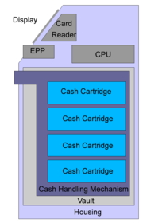
HardWare
- CPU
- Card Reader
- Secure Cryptoprocessor
- Cash Dispenser
- Display Screen
- Function Key Button or Touch Screen
- Record Printer
- Vault
- Housing

Slide 8
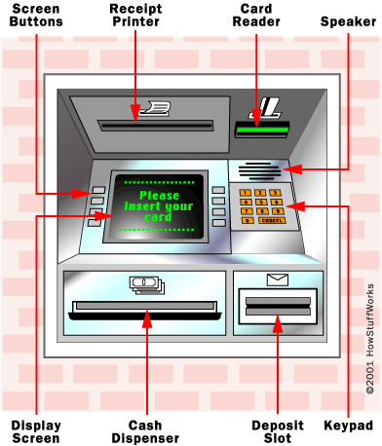
HardWare cont.

Slide 9
Financial network and ATM
- Logical connection : interbank networks
( PLUS, Cirrus, South Africa’s SASWITCH, Hong
Kong’s JETCO, Philippines’ Expressnt …)
- Physical connection :
- dial-up modem over telephone line
- leased line

Slide 10
Security
- Physical
- Transactional Secrecy and Integrity
- Customer Identity Integrity

Slide 11
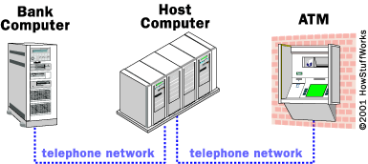
How ATMs Work?

Slide 12
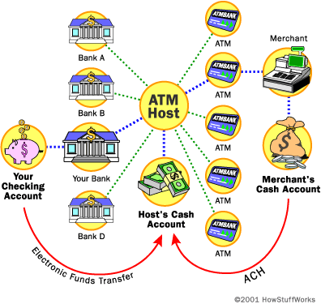
How ATMs Work?cont.

Slide 13
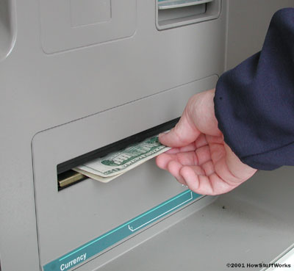
Sending Bills
- ATMs uses an electric
eye for counting bills…

Slide 14
Alternative Uses
- Deposit currency recognition, acceptance, recycling
- Updating passbooks
- Loading monetary value into prepaid card
- Ticket purchase
- Purchasing postal stamps
- Lottery ticket purchase
- Advertising
- …

Slide 15
New Technologies
- Biometrics
- Cheque / cash acceptation
- Barcode scanning
- On–demand printing of item value
- Display additional media such as phone card
- Co–ordination of ATMs with mobile phone
- Customer – specific advertising
- …

